Slide 1
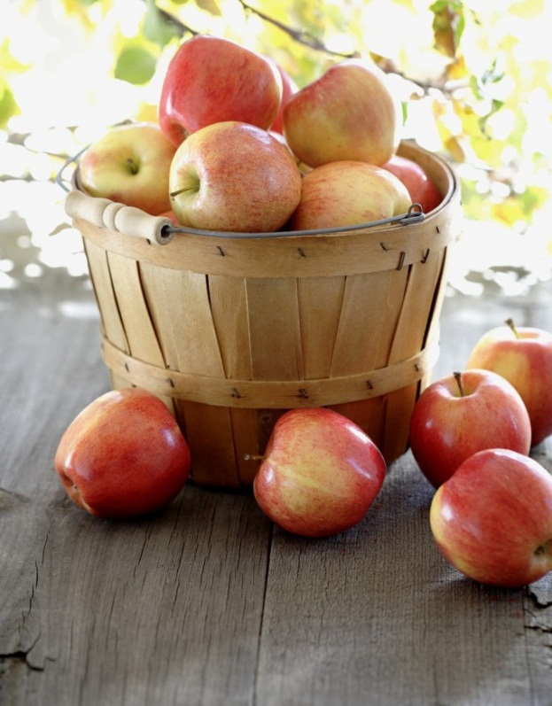
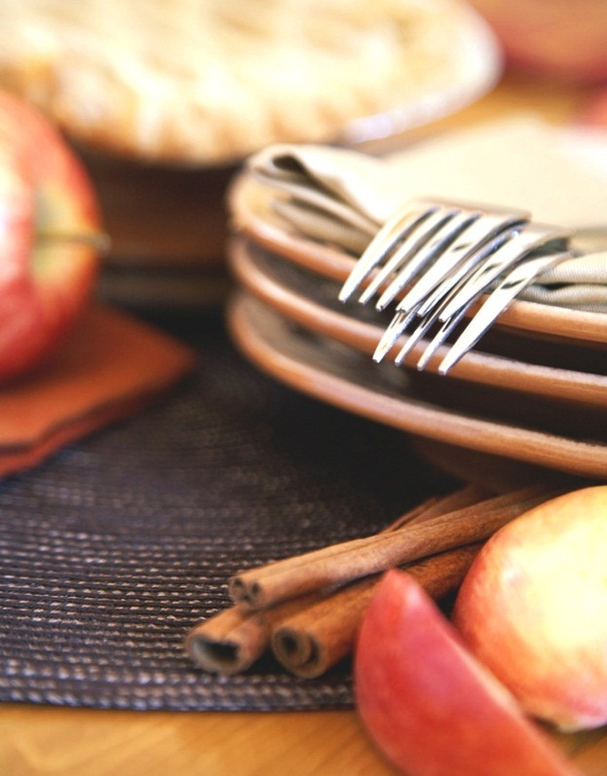
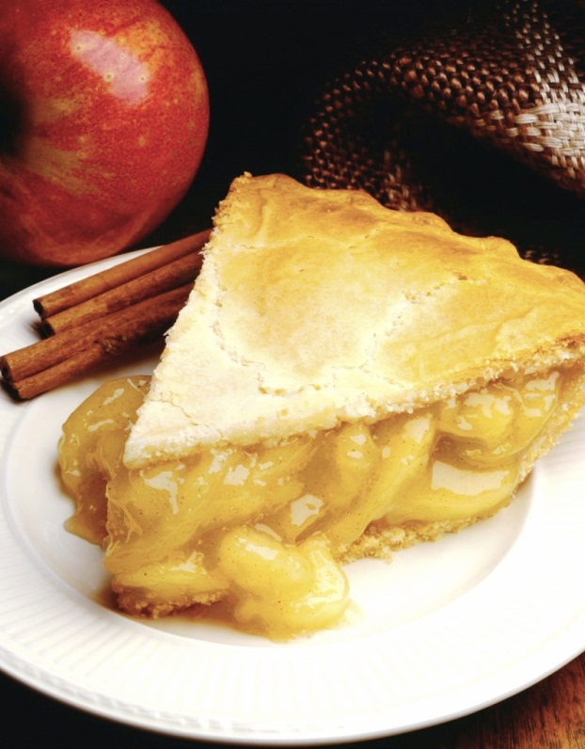
Personalized Healthy Diet Planning
DSC5101 Final Project Presentation
CAO CHANG | A0054785U
HE WENJING | A0119462E
LI LIPING | A0186040M
LIANG SHIJIE | A0186001U
NANXIN WANG | A0186038Y
QIU XU | A0112611B
SAIYA JIANG | A0186002R
Notes:
NOTE: To replace a picture, just select and delete it. Then use the Insert Picture icon to replace it with one of your own!

Slide 2
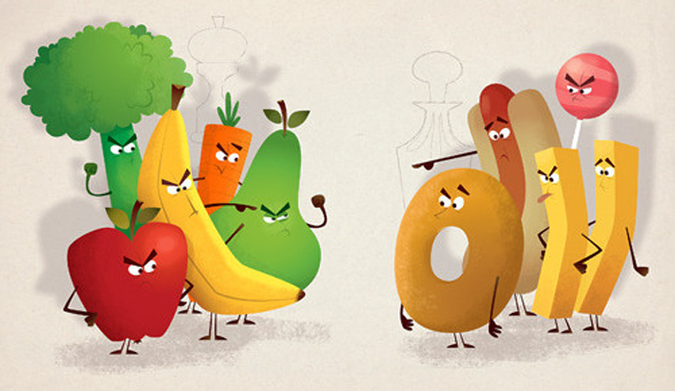
Overview
Introduction
Data Collection
Problem Formulation
Results & Future work

Slide 3
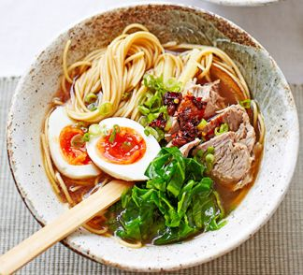

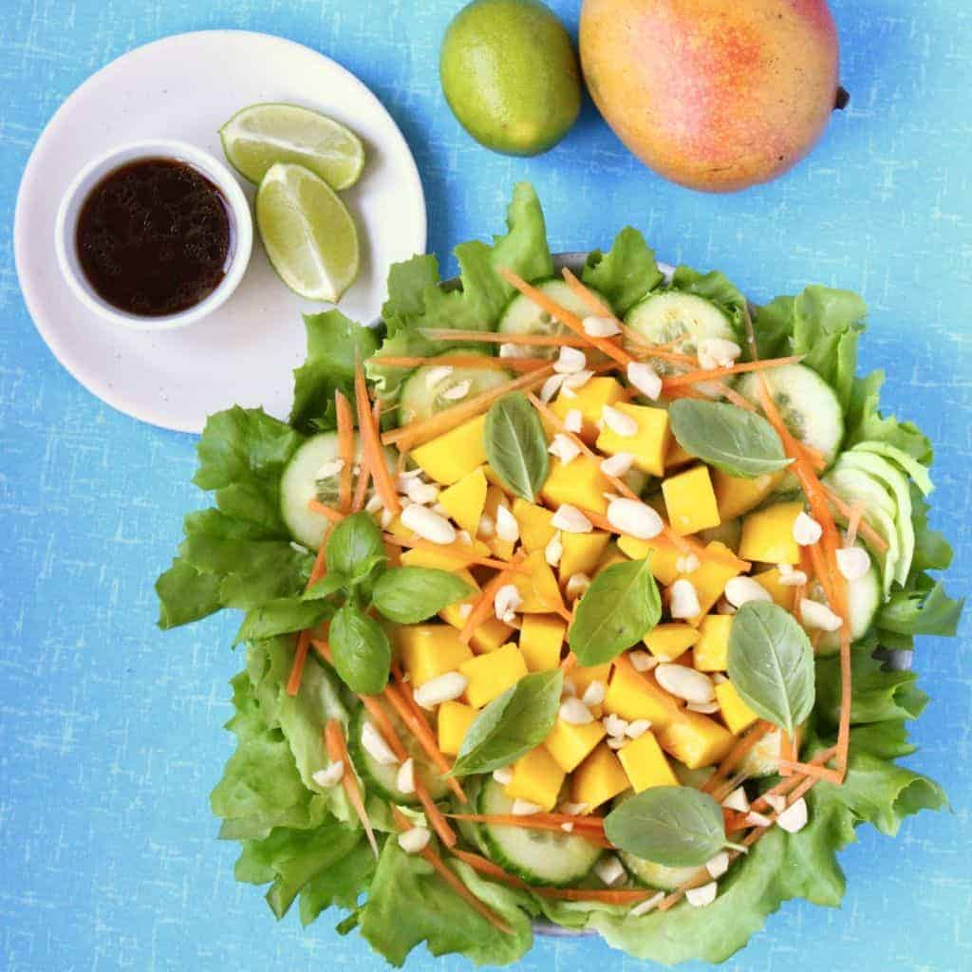
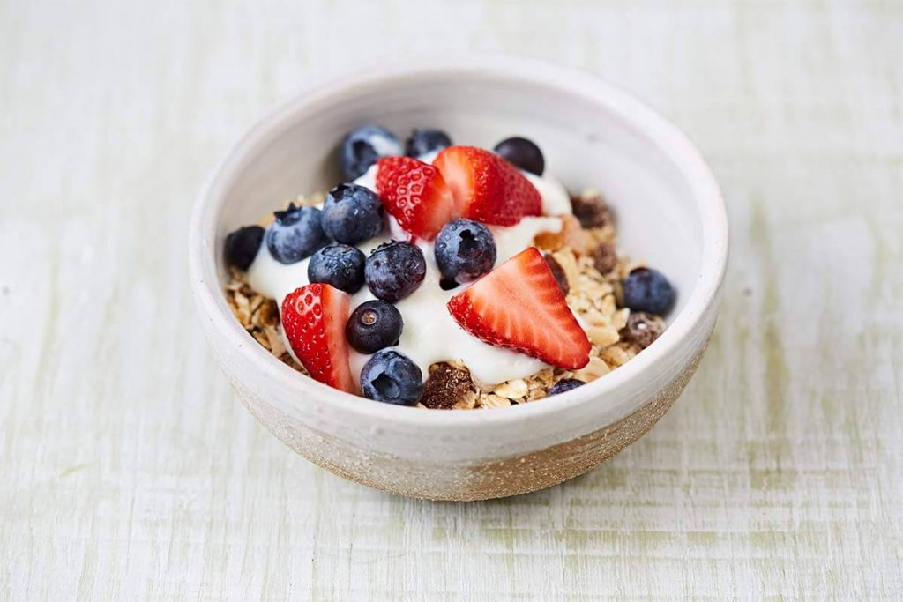
01 Introduction

Slide 4

How to eat healthy?

Slide 5

Problem Definition
Minimize daily excess calories/fat/cholesterol intake while meeting the needs of various nutrients and other constraints.
Diversified dietary planning based on dietary requirements of different user groups.

Slide 6
Problem Definition
Minimize daily excess calories/fat/cholesterol intake while meeting the needs of various nutrients and other constraints.
Personalised dietary planning based on different preference and characteristics of users on campus.
Dynamic dietary modification based on the actual situation of the implementation.

Slide 7
02 Data Collection

Slide 8
Data Collection
Estimated Calorie Needs per Day, by Age, Sex, and Physical Activity Level
Data source : Office of Disease Prevention and Health Promotion, US
Male |  |  |  | Female
AGE | Sedentary | Moderately active | Active | AGE | Sedentary | Moderately active | Active
18 | 2400 | 2800 | 3200 | 18 | 1800 | 2000 | 2400
19-20 | 2600 | 2800 | 3200 | 19-20 | 2000 | 2200 | 2400
21-25 | 2400 | 2800 | 3200 | 21-25 | 2000 | 2200 | 2400
26-30 | 2400 | 2600 | 3000 | 26-30 | 1800 | 2200 | 2400
…...
Sedentary: A lifestyle that includes only the physical activity of independent living.
Moderately Active: A lifestyle that includes physical activity equivalent to walking about 1.5 to 3 miles per day at 3 to 4 miles per hour, in addition to the activities of independent living.
Active: A lifestyle that includes physical activity equivalent to walking more than 3 miles per day at 3 to 4 miles per hour, in addition to the activities of independent living.

Slide 9
Data Collection
Daily Recommended Dietary Intake: by Age, Gender, and Physical Activity Level
Nutrient |  | 18-30 yrs Men (Sedentary) | 18-30 yrs Women (Sedentary) | 18-30 yrs Men (Active) | 18-30 yrs Women (Active)
Energy (Kcal) | > | 2400 | 1800 | 3100 | 2400
Protein (g) | > | 56 | 46 | 127 | 109
Fiber (g) | > | 33 | 28 | 33 | 28
Carbohydrate (g) | > | 130 | 130 | 230 | 244
Cholesterol | < | 300 | 300 | 300 | 300
Sodium | < | 2400 | 2400 | 2400 | 2400
Total fat | < | 90 | 69 | 90 | 69
Saturated fat | < | 30 | 23 | 30 | 23
Notes:
https://health.gov/dietaryguidelines/2015/guidelines/appendix-7/
https://www.ncbi.nlm.nih.gov/pmc/articles/PMC5084025/

Slide 10
Data Collection
Food data are collected from Singapore Health Promotion Board website.
Food available in hawker centers/canteens
59 main courses
27 breakfast types
17 beverage choices
10 kinds of fruit
7 desserts
Nutrition information
Food | Energy (kcal) | Protein (g) | Total fat (g) | Saturated fat (g) | Dietary fibre (g) | Carbohydrate (g) | Cholesterol (mg) | Sodium (mg)
Bak kut teh | 323.71 | 28.11 | 23.43 | 9.37 | 0 | 0 | 153.34 | 1316.15
Wanton noodles soup | 318.04 | 25.14 | 7 | 1.85 | 1.74 | 36.57 | 76.03 | 1969.63
Black carrot cake | 556.47 | 13.16 | 26.74 | 10.05 | 1.54 | 65.77 | 205.8 | 1937.08

Slide 11
03 Problem Formulation

Slide 12
Problem Formulation: One day planning
Assumptions
Essential: 1 breakfast, 2 main meals
Optional: maximum 2 beverages , maximum 2 fruits, maximum 2 desserts
Nutrition constraints
Gender
Exercise routine
Certain food allergy

Slide 13
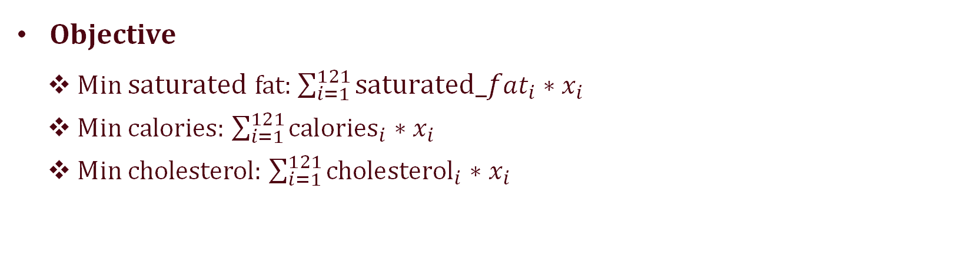
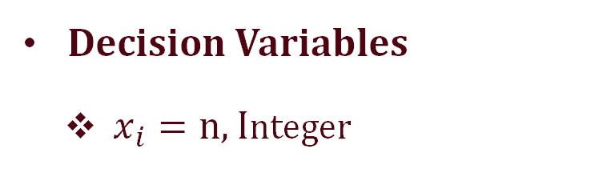
Problem Formulation: One day planning
Objective
Min saturated fat: $\sum_{i=1}^{121}{{\text{s}\text{aturated}_fat}_{i}∗x_{i}}$
Min calories: $\sum_{i=1}^{121}{{\text{calories}}_{i}∗x_{i}}$
Min cholesterol: $\sum_{i=1}^{121}{{\text{cholesterol}}_{i}∗x_{i}}$
Decision Variables
$x_{i}=n, I$nteger
eating the meal i for n times in a day. $i ∈\{1,2…121\}$
Notes:
We allow n to be integer instead of binary here as we would like to consider eating one food twice a day.

Slide 14
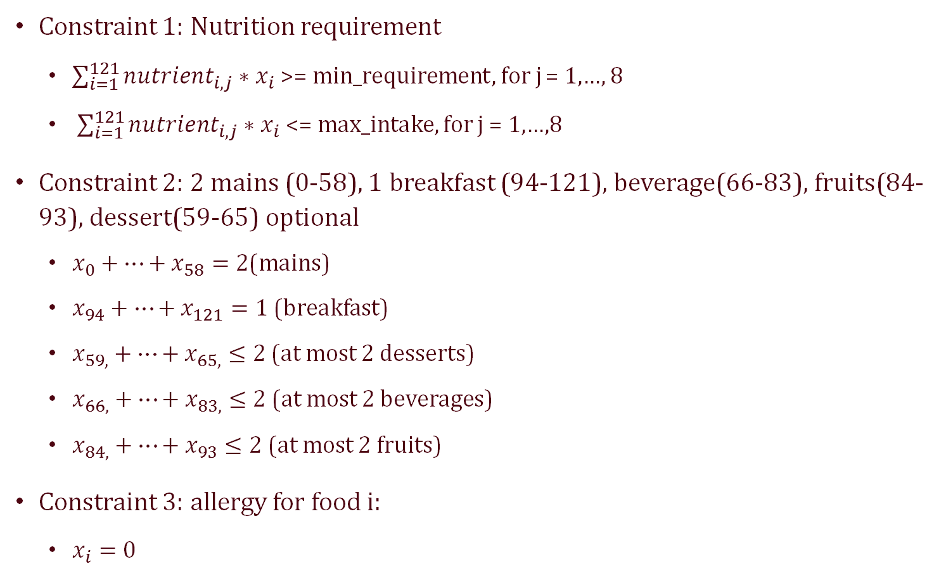
Problem Formulation：One day planning
Constraint 1: Nutrition requirement
$\sum_{i=1}^{121}{{nutrient}_{i,j}∗x_{i}}$ >= min_requirement, for j = 1,…, 8
$\sum_{i=1}^{121}{{nutrient}_{i,j}∗x_{i}}$<= max_intake, for j = 1,…,8
Constraint 2: 2 mains (0-58), 1 breakfast (94-121), beverage(66-83), fruits(84-93), dessert(59-65) optional
$x_{0}+…+x_{58}=2$(mains)
$x_{94}+…+x_{121}=1$(breakfast)
$x_{59,}+…+x_{65,}≤2$(at most 2 desserts)
$x_{66,}+…+x_{83,}≤2$(at most 2 beverages)
$x_{84,}+…+x_{93}≤2$(at most 2 fruits)
Constraint 3: allergy for food i:
$x_{i}=0$

Slide 15
Preliminary Result
Optimizing calorie intake for a 1800 kcal diet, female (obj:1800)
Cat | Food Name | Energy (kcal) | Protein (g) | Total fat (g) | Saturated fat (g) | Dietary fibre (g) | Carbo-hydrate (g) | Choles-terol (mg) | Sodium (mg)
Breakfast | Red rice porridge | 74.24 | 2.3 | 0.51 | 0.15 | 1.02 | 15.1 | 0 | 7.68
Main | Salmon and Teriyaki Chicken Bento | 664.54 | 28.54 | 16.99 | 5.17 | 8.03 | 99.9 | 0 | 1097.16
 | Salmon and Teriyaki Chicken Bento | 664.54 | 28.54 | 16.99 | 5.17 | 8.03 | 99.9 | 0 | 1097.16
Dessert | Beancurd Dessert with Red Bean Toppings | 164.64 | 9.8 | 5.25 | 2.63 | 7.45 | 19.6 | 0 | 50.18
Beverage | Sugar cane juice | 126.24 | 0.79 | 0 | 0 | 1.58 | 26.04 | 0 | 2.63
Fruit | Dragonfruit | 105.84 | 2.81 | 0.22 | 0.04 | 5.83 | 22.9 | 0 | 25.92

Slide 16
Problem Formulation: one week planning
Assumptions
Every day
Essential: 1 breakfast, 2 main meals, maximum 2 beverage
Optional: maximum 2 fruits , maximum 2 desserts
Nutrition constraints for each day
Gender
Exercise routine
Certain food allergy
max 2 repetition of meal in one week (consider only 5 weekdays)

Slide 17
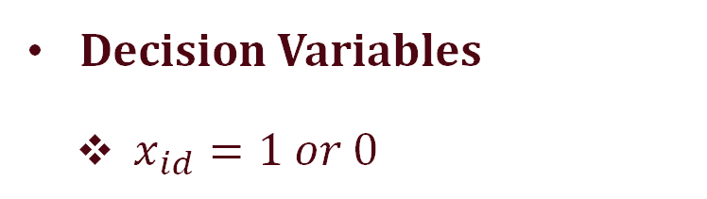
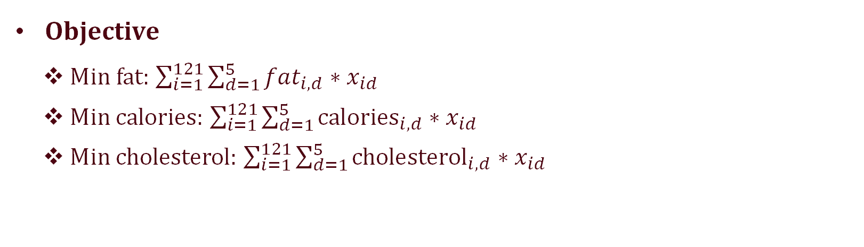
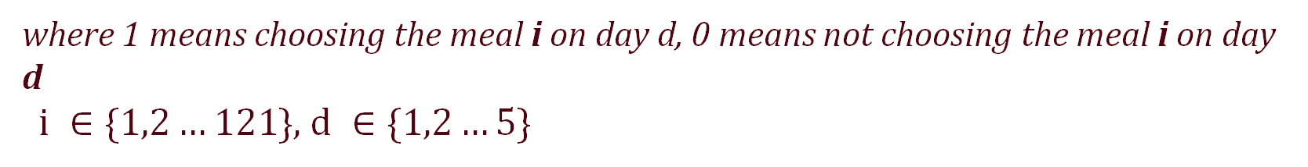
Problem Formulation: one week planning
Objective
Min fat: $\sum_{i=1}^{121}{\sum_{d=1}^{5}{{fat}_{i,d}∗x_{id}}}$
Min calories: $\sum_{i=1}^{121}{\sum_{d=1}^{5}{{\text{calories}}_{i,d}∗x_{id}}}$
Min cholesterol: $\sum_{i=1}^{121}{\sum_{d=1}^{5}{{\text{cholesterol}}_{i,d}∗x_{id}}}$
Decision Variables
$x_{id}=1 or 0$
where 1 means choosing the meal i on day d, 0 means not choosing the meal i on day d
$i ∈\{1,2…121\}$, $d ∈\{1,2…5\}$

Slide 18
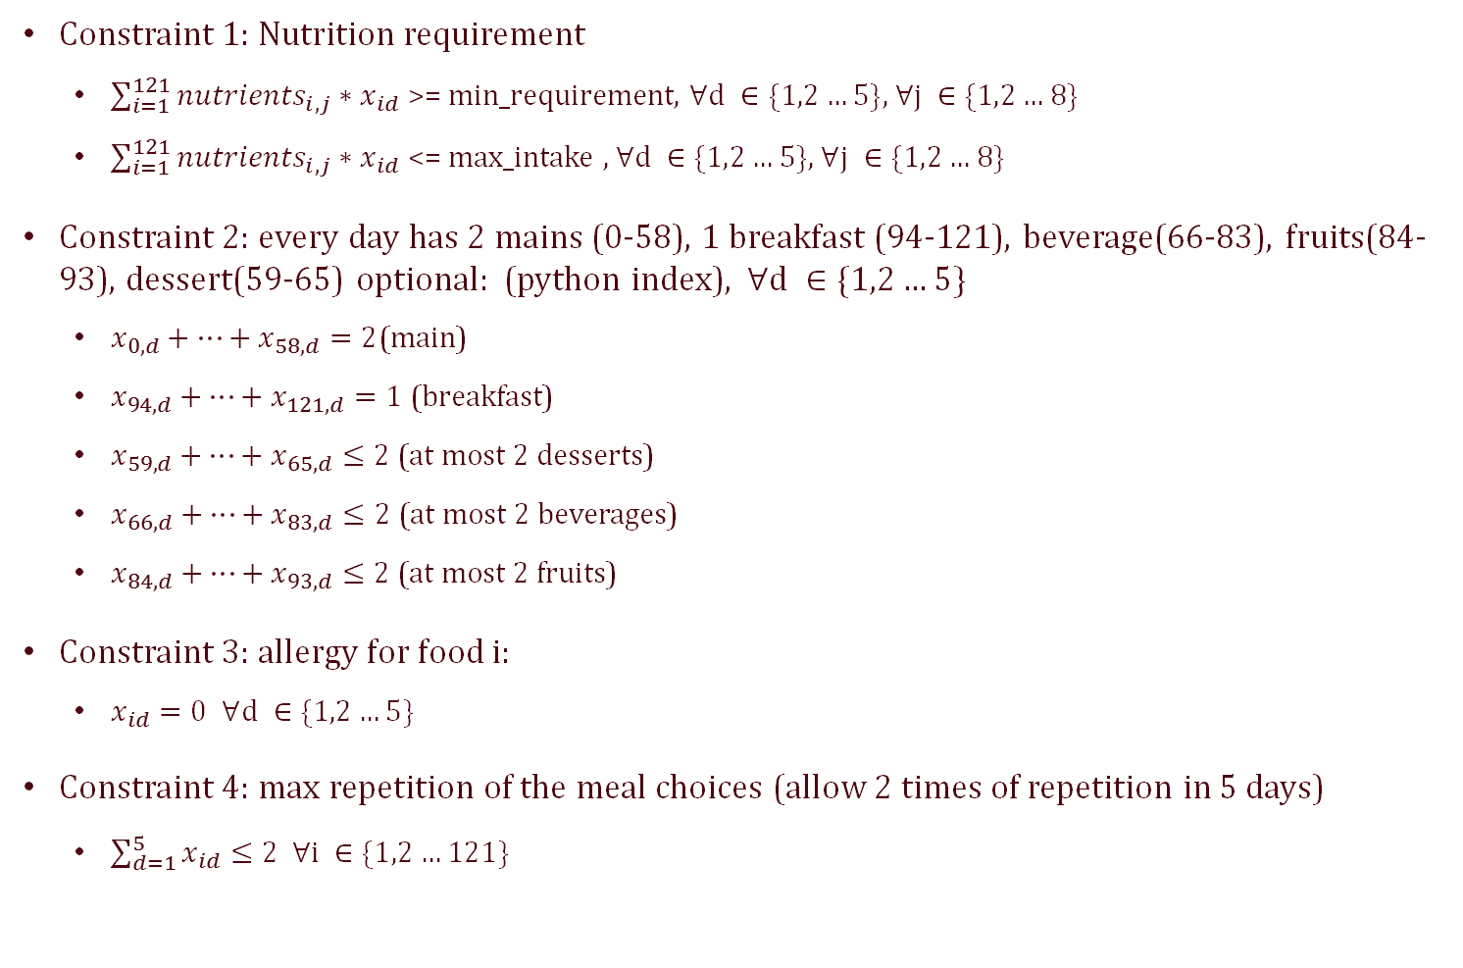
Problem Formulation: one week planning
Constraint 1: Nutrition requirement
$\sum_{i=1}^{121}{{nutrients}_{i,j}∗x_{id}}$ >= min_requirement, $∀d ∈\{1,2…5\}$, $∀j ∈\{1,2…8\}$
$\sum_{i=1}^{121}{{nutrients}_{i,j}∗x_{id}}$ <= max_intake , $∀d ∈\{1,2…5\}\text{, }∀j ∈\{1,2…8\}$
Constraint 2: every day has 2 mains (0-58), 1 breakfast (94-121), beverage(66-83), fruits(84-93), dessert(59-65) optional: (python index), $∀d ∈\{1,2…5\}$
$x_{0,d}+…+x_{58,d}=2$(main)
$x_{94, d}+…+x_{121, d}=1$(breakfast)
$x_{59, d}+…+x_{65, d}≤2$(at most 2 desserts)
$x_{66, d}+…+x_{83, d}≤2$(at most 2 beverages)
$x_{84, d}+…+x_{93, d}≤2$(at most 2 fruits)
Constraint 3: allergy for food i:
$x_{id}=0$ $∀d ∈\{1,2…5\}$
Constraint 4: max repetition of the meal choices (allow 2 times of repetition in 5 days)
$\sum_{d=1}^{5}{x_{id}}≤2 ∀i ∈\{1,2…121\}$

Slide 19
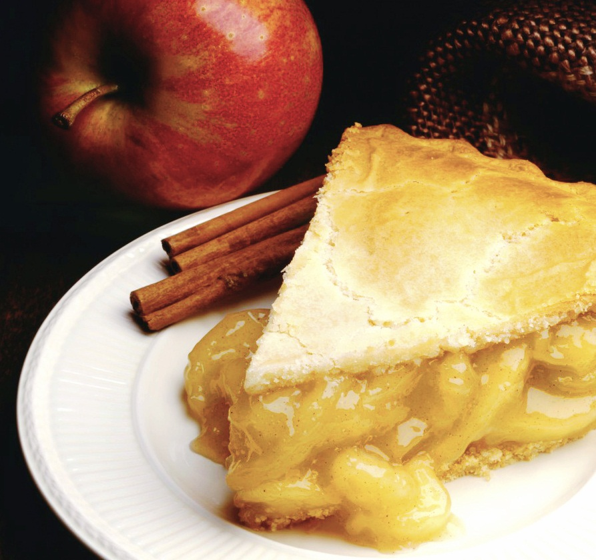
Results & Conclusion
Food plan for a typical week in NUS
Following result based on a 1800kcal diet per day (for sedentary females)

Slide 20
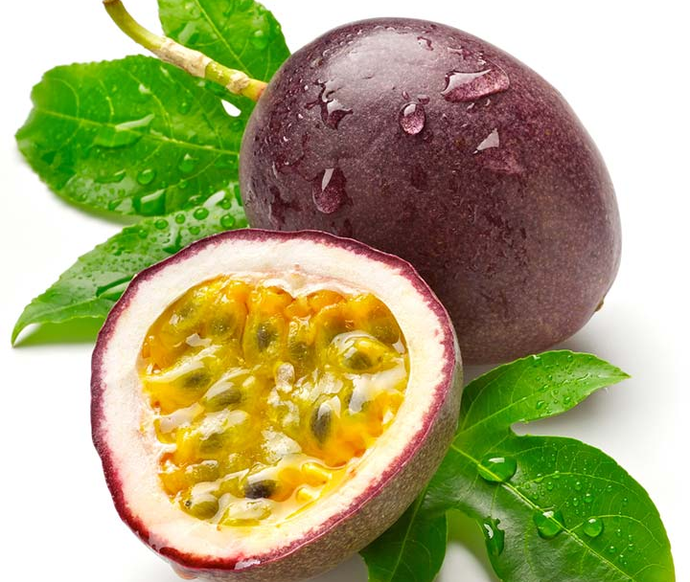

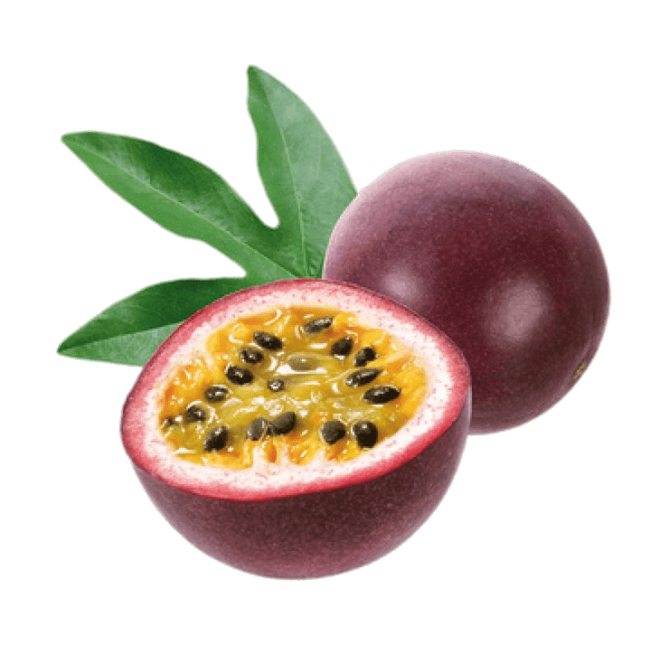
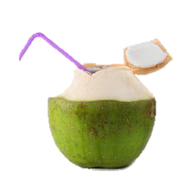
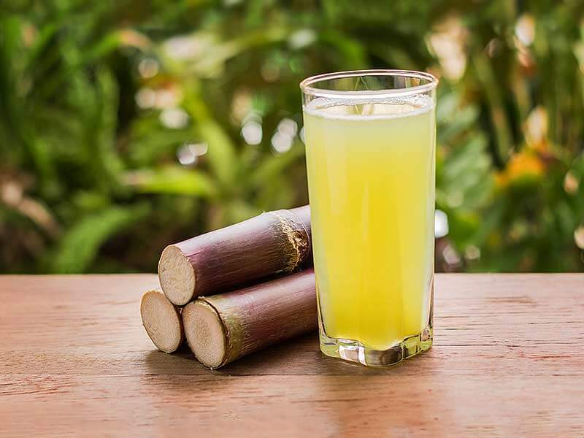
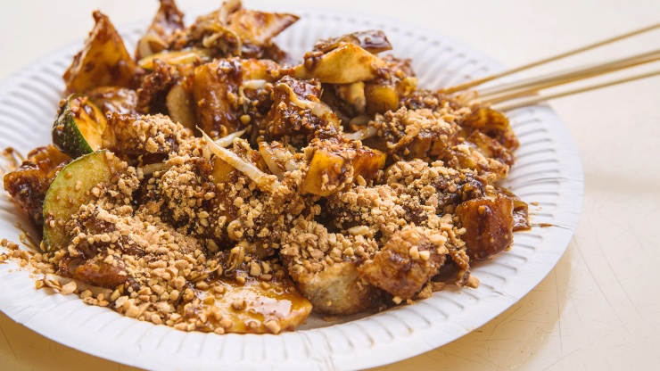
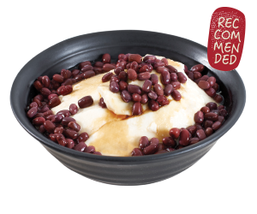
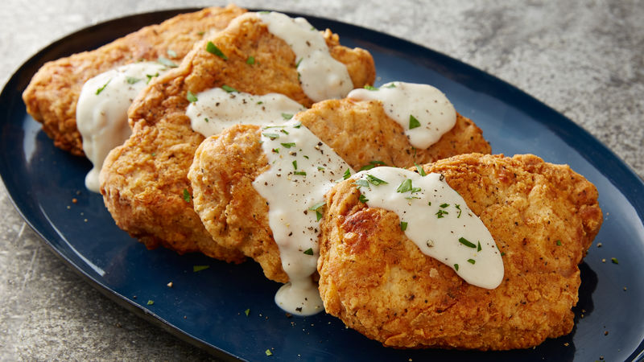
Monday
Breakfast
Fruits
Wholegrain Cereal
Passionfruit
banana
Lunch & Dinner
Drinks
Chinese Rojak
Coconut juice
Sugar Cane Juice
Pork Chop
Dessert
Beancurd with red bean toppings

Slide 21
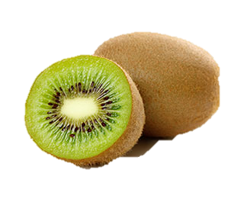

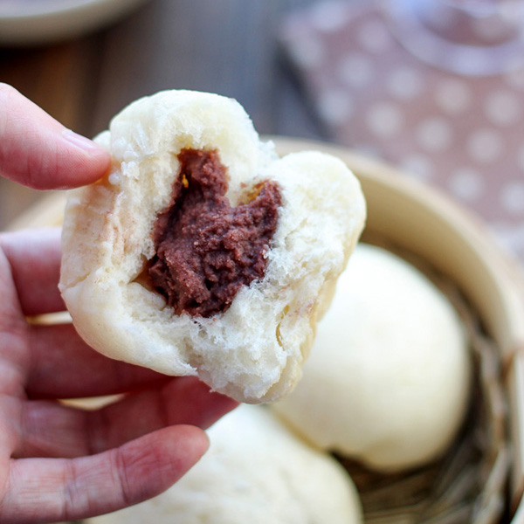
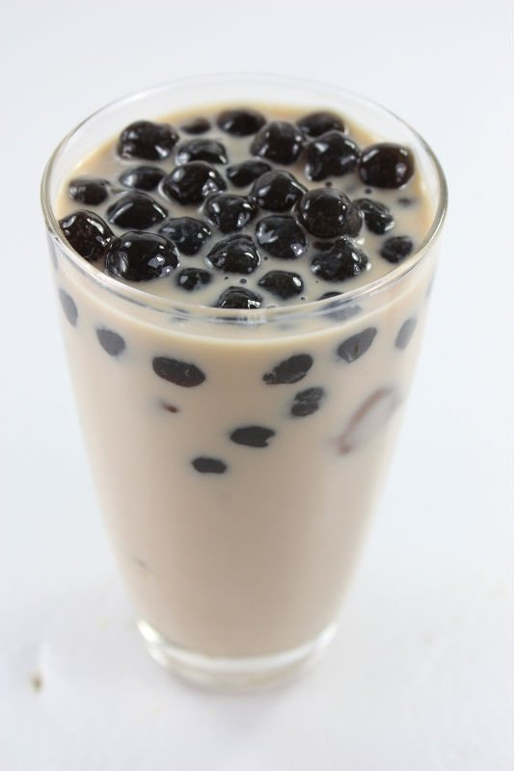
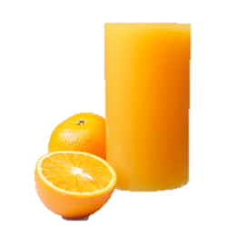
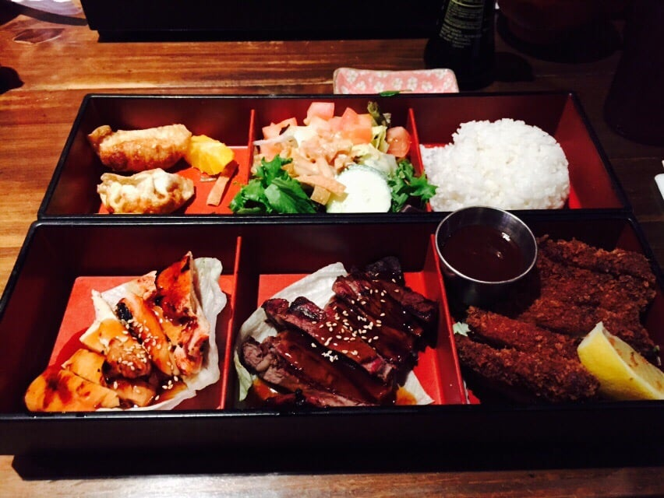
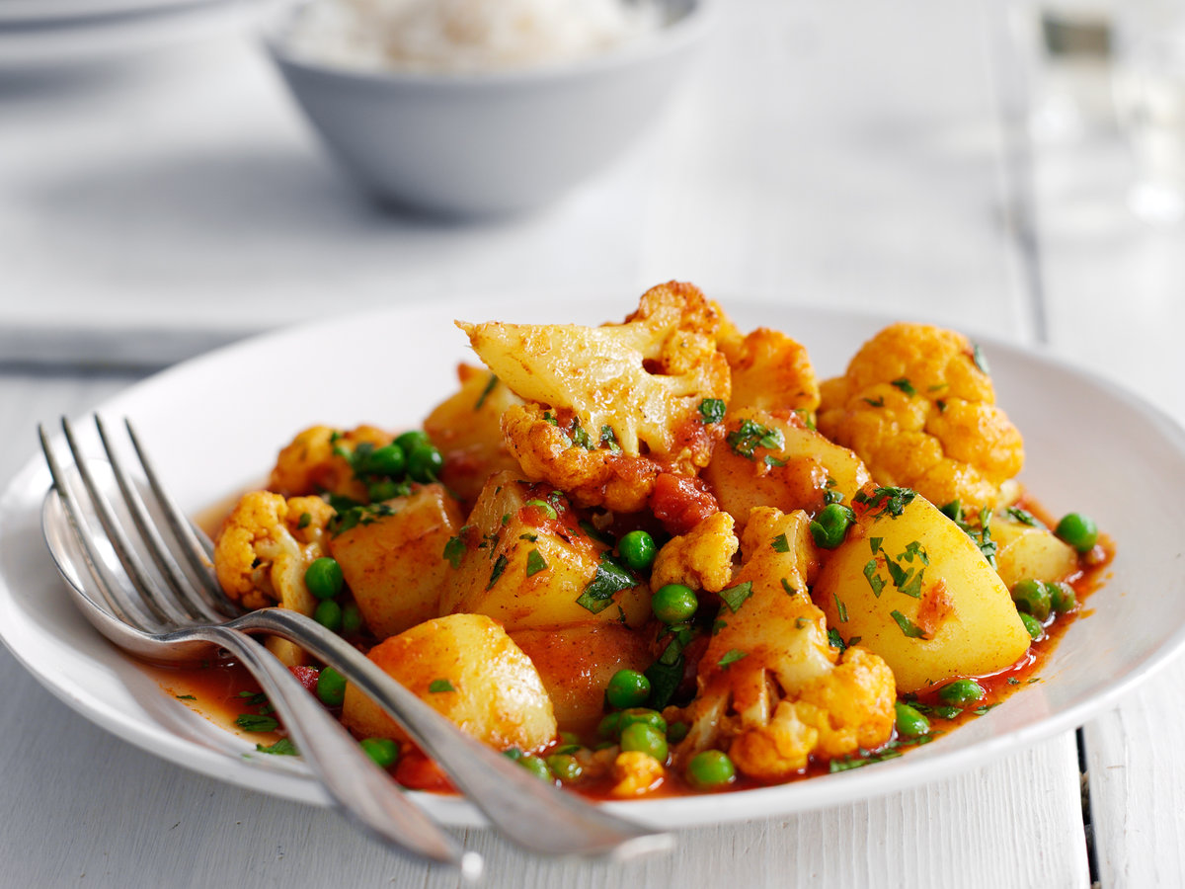
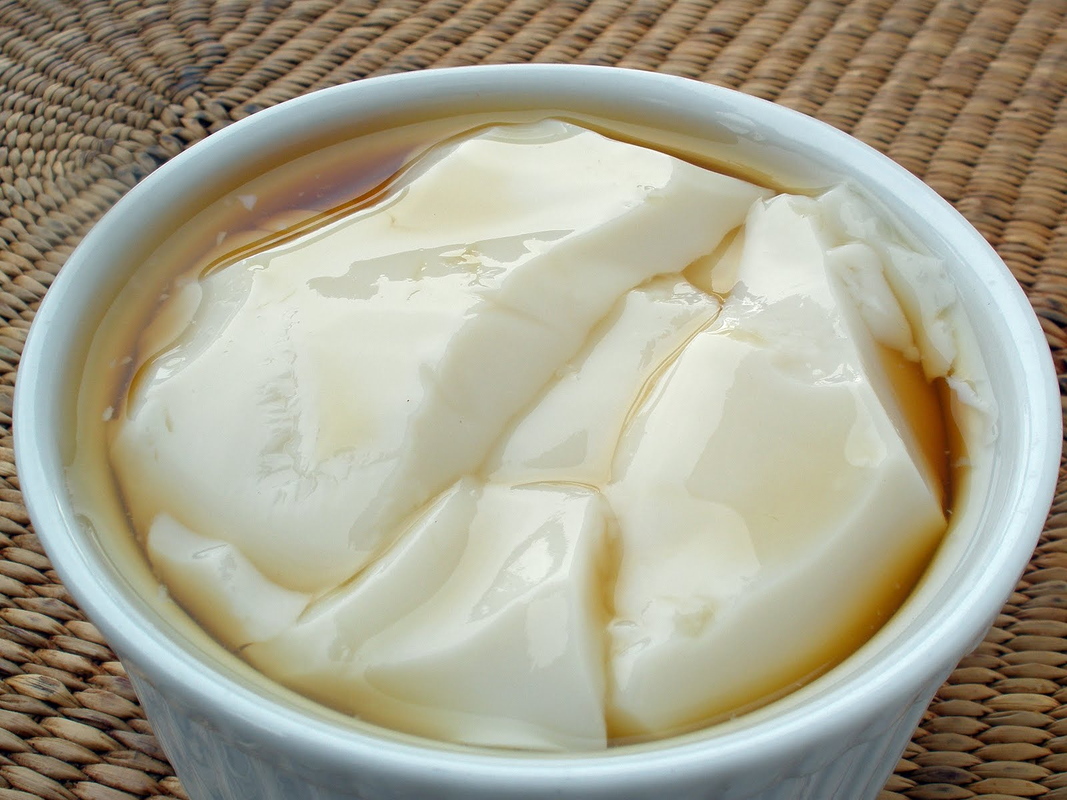
Tuesday
Breakfast
Fruits
Red bean bun
Kiwifruit
Apple
Lunch & Dinner
Drinks
Beef and Teriyaki Chicken Bento
Milk tea with pearls, 0% sugar
Orange juice
Indian stewed potato and peas
Dessert
Soya bean curd, less sweet

Slide 22
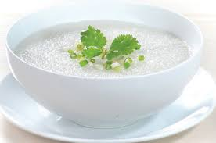
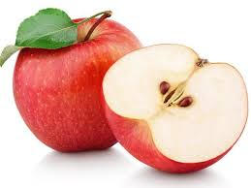


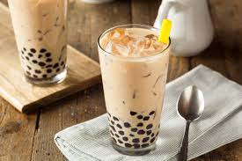
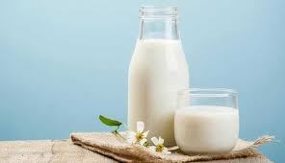
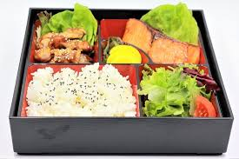
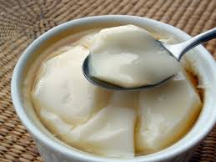
Wednesday
Breakfast
Plain porridge
Fruit & Beverage
Apple
Banana
Lunch & Dinner
India stewed
potato and peas
Salmon and teriyaki
chicken bento
Drink
Milk tea
Milk
Dessert
Soya bean curd

Slide 23
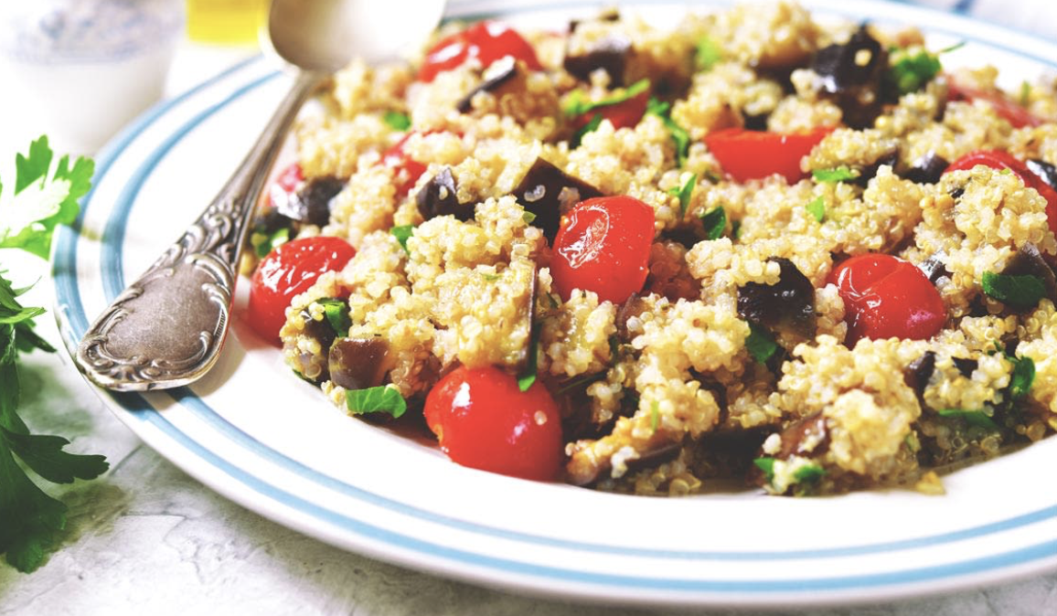
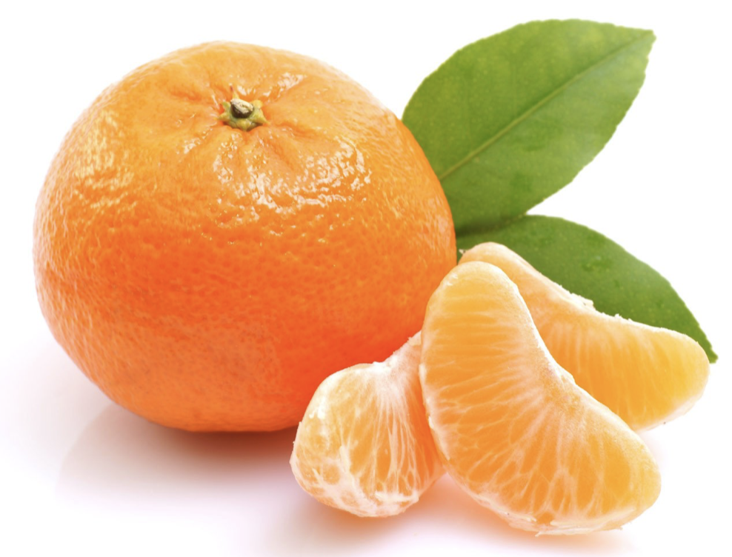
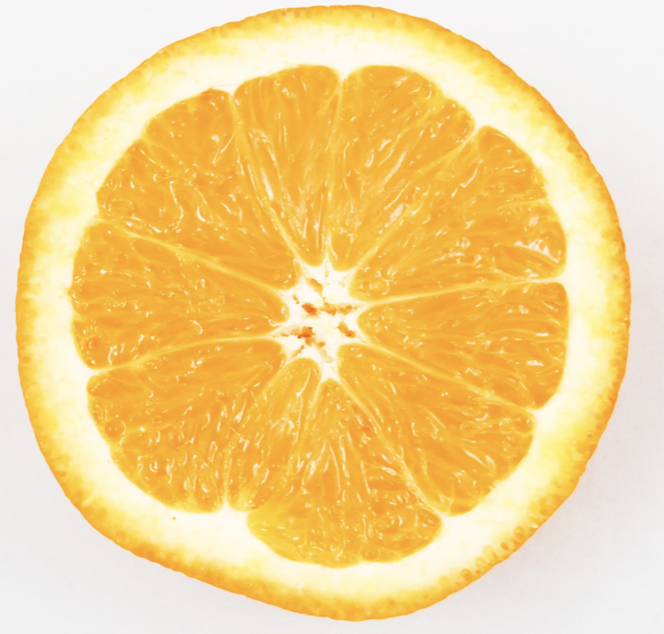

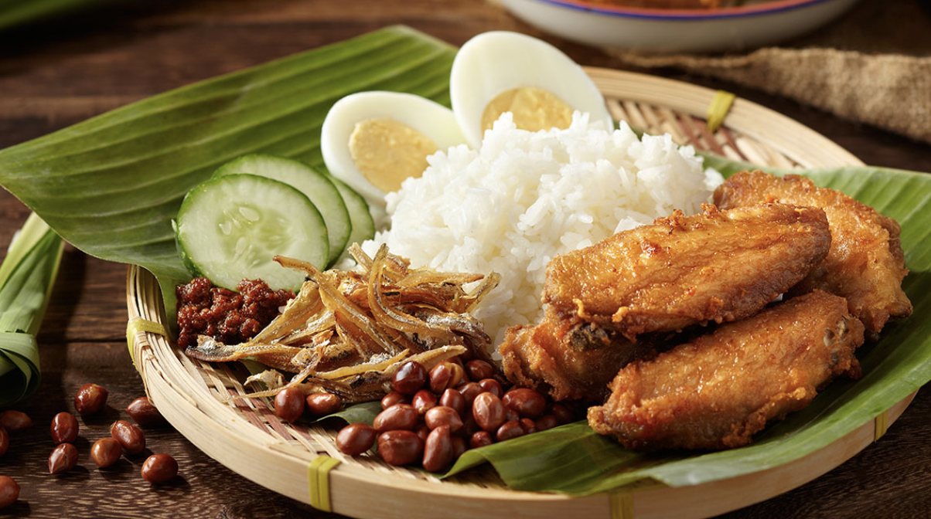
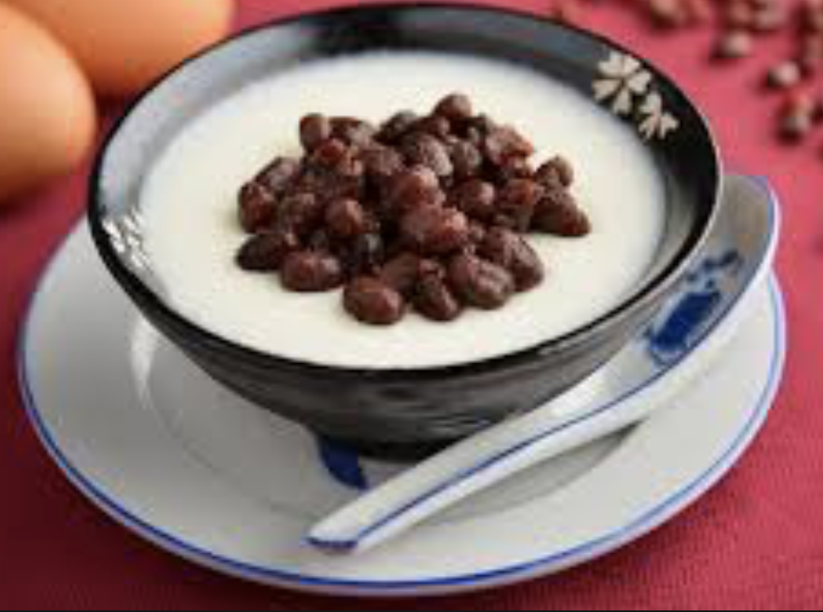
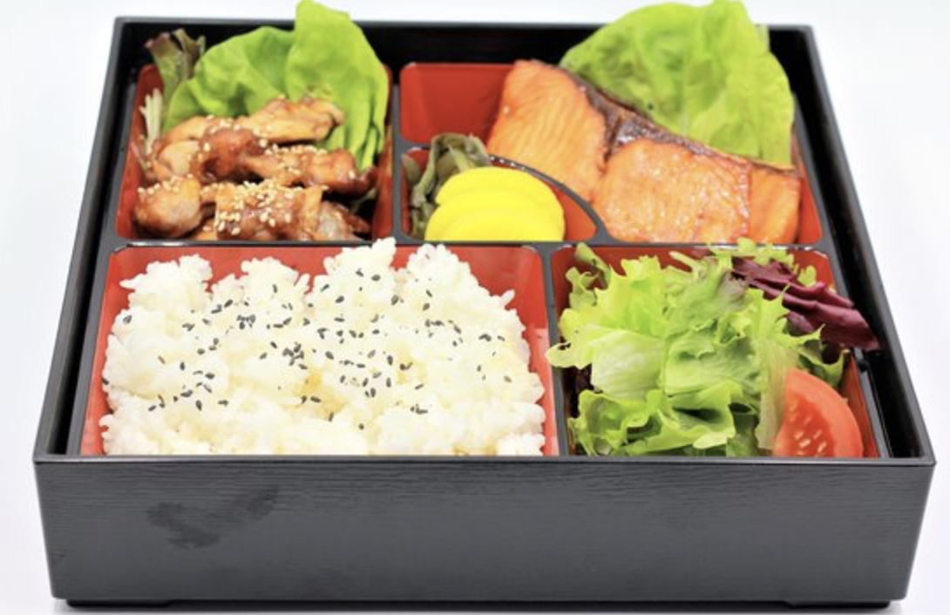
Thursday
Breakfast
Fruit & Beverage
Mandarin orange
Orange
Breakfast cereal
Lunch & Dinner
Drink
Coke
Nasi Lemak with chicken wing
Salmon and Teriyaki Chicken Bento
Dessert
Bean curd with
red bean topping
Notes:
Coke has a bit high calories – hence only 1 drink in this day

Slide 24
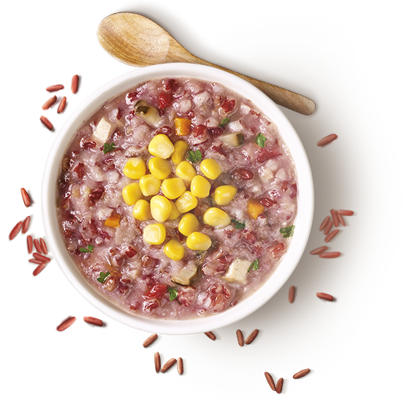
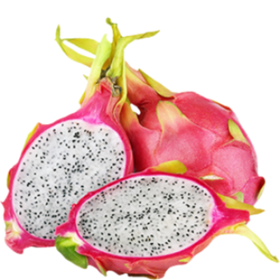
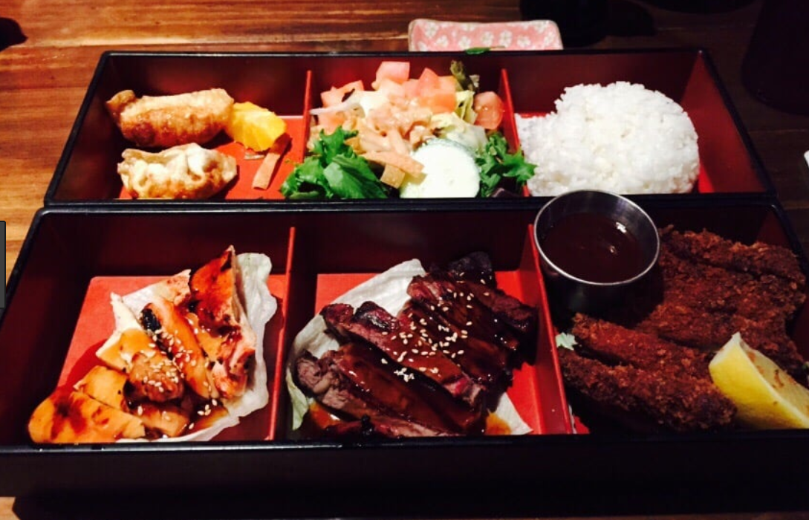
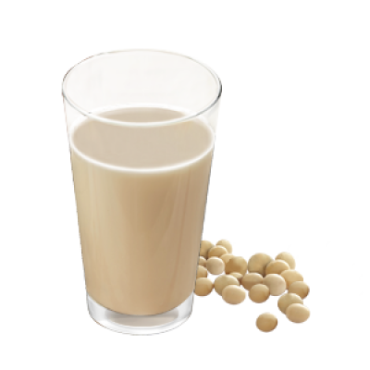
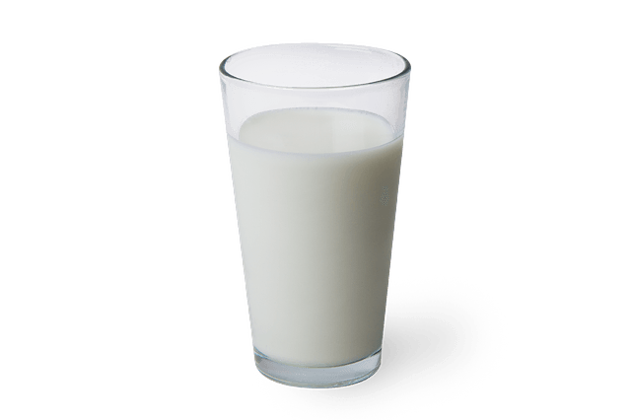
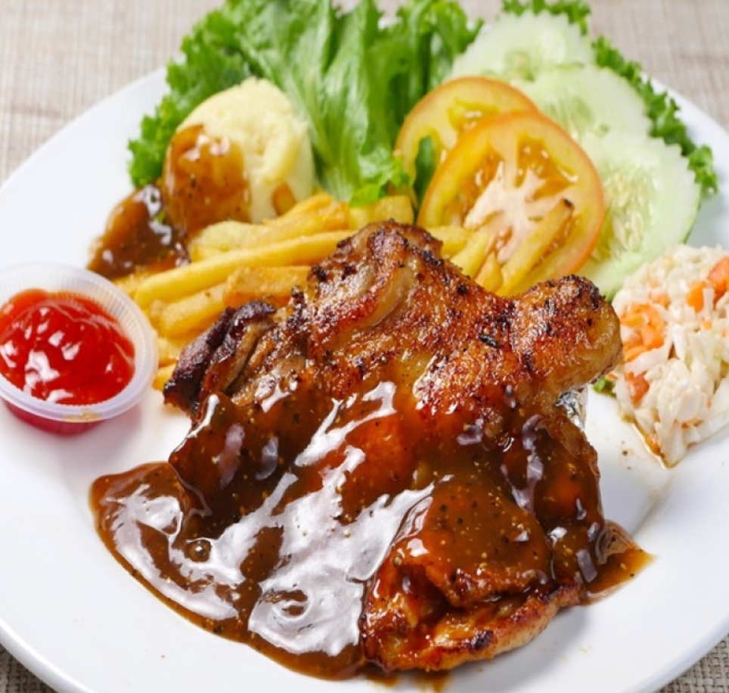
Friday
Breakfast
Red Rice Porridge
Fruits
Passionfruit
Dragonfruit
Lunch & Dinner
Beef and Teriyaki Chicken Bento
Drinks
Grilled Chicken Chop
Soya milk no sugar
Low fat milk

Slide 25
Future Work
To collect more data:
Currently our dataset is too small for the LP to return a food plan without repetition for a week - including more data will resolve this problem.
To include more functions into problem formulation:
Objective: Minimize cost/maximize satisfaction according to preferences
Achieved by adding cost/preference score(scaled) in raw data

Slide 26
Thank you!

Slide 28
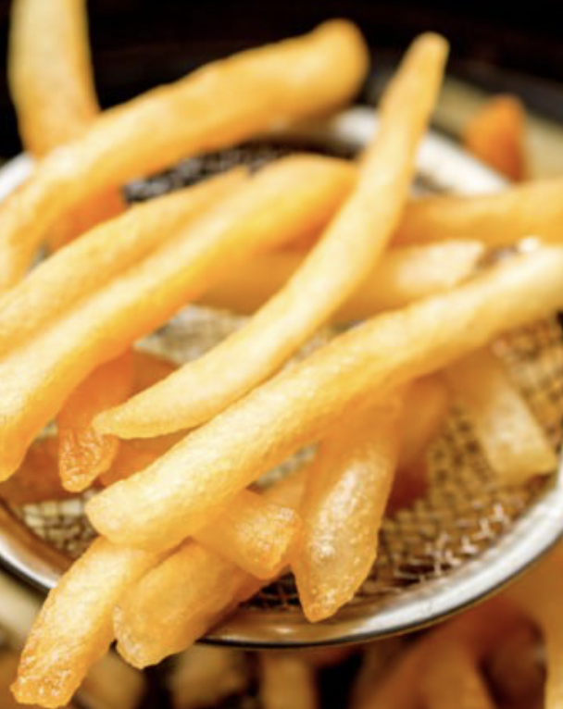
Problem Formulation
Factors to consider:
Gender
Exercise routine
Every day: 2 main meals, 1 breakfast , maximum 2 beverage, maximum 2 fruits , maximum 2 desserts
2 repetition of meal in one week (consider only 5 weekdays)
Customer is determined to eat certain food/disgard certain food due to allergy
Dynamic optimization: if one day constraint is violated, the following days options will change accordingly
Nutrition constiants for each day:
Nutrient | Recommended | 18-30 yrs Men without Excercise | 18-30 yrs Women without Excercise | 18-30 yrs Men with Excercise | 18-30 yrs Women with Excercise
Energy (Kcal) | Larger than | 2400 | 1800 | 3100 | 2400
Protein (g) | Larger than | 56 | 46 | 127 | 109
Fiber (g) | Larger than | 33 | 28 | 33 | 28
Carbohydrate (g) | Larger than | 130 | 130 | 230 | 244
Cholesterol | Less than | 300 | 300 | 300 | 300
Sodium | Less than | 2400 | 2400 | 2400 | 2400
Total fat | Less than | 90 | 69 | 90 | 69
Saturated fat | Less than | 30 | 23 | 30 | 23

Slide 29
Problem Formulation
Objective:
Min fat
Min calories
Min cholesterol
Decision Variables:
xid = 1,0; where 1 means choosing the meal i and 0 means not choosing the meal I on day d. i ∈{1,2…121} d ∈{1,2…5}

Slide 30
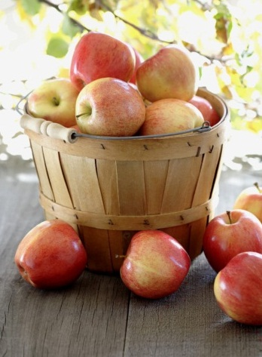
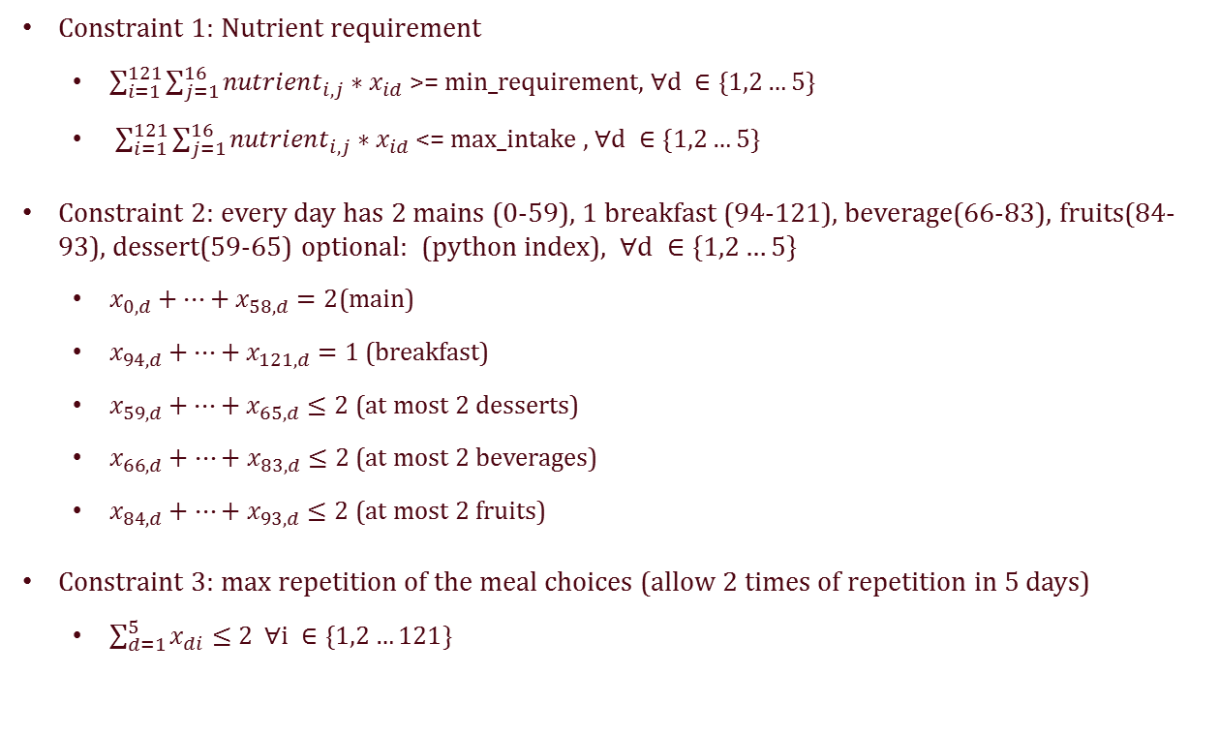
Problem Formulation
Constraint 1: Nutrient requirement
$\sum_{i=1}^{121}{\sum_{j=1}^{16}{{nutrient}_{i,j}∗x_{id}}}$ >= min_requirement, $∀d ∈\{1,2…5\}$
$\sum_{i=1}^{121}{\sum_{j=1}^{16}{{nutrient}_{i,j}∗x_{id}}}$<= max_intake , $∀d ∈\{1,2…5\}$
Constraint 2: every day has 2 mains (0-59), 1 breakfast (94-121), beverage(66-83), fruits(84-93), dessert(59-65) optional: (python index), $∀d ∈\{1,2…5\}$
$x_{0,d}+…+x_{58,d}=2$(main)
$x_{94, d}+…+x_{121, d}=1$(breakfast)
$x_{59, d}+…+x_{65, d}≤2$(at most 2 desserts)
$x_{66, d}+…+x_{83, d}≤2$(at most 2 beverages)
$x_{84, d}+…+x_{93, d}≤2$(at most 2 fruits)
Constraint 3: max repetition of the meal choices (allow 2 times of repetition in 5 days)
$\sum_{d=1}^{5}{x_{di}}≤2 ∀i ∈\{1,2…121\}$

Slide 31
Prelimilary Results:
Category | Food Name | Energy (kcal) | Protein (g) | Total fat (g) | Saturated fat (g) | Dietary fibre (g) | Carbohydrate (g) | Cholesterol (mg) | Sodium (mg)
Main | Chicken chop, grilled | 679 | 51.5 | 30.58 | 12.08 | 6.97 | 49.87 | 76.4 | 655.2
Main | Beef and Teriyaki Chicken Bento | 743.28 | 43.03 | 20.88 | 7.92 | 10.76 | 95.35 | 0 | 1515.9
Beverage | Soya bean milk, without sugar | 82.5 | 6.75 | 5 | 0.65 | 2 | 3 | 0 | 30
Beverage | Soya bean milk, without sugar | 82.5 | 6.75 | 5 | 0.65 | 2 | 3 | 0 | 30
Beverage | Milk, low fat | 97.5 | 9 | 1.5 | 1.08 | 0.75 | 12 | 7.5 | 100
Fruit | Dragonfruit | 105.84 | 2.81 | 0.22 | 0.04 | 5.83 | 22.9 | 0 | 25.92
Fruit | Passion fruit | 17.65 | 0.4 | 0.13 | 0.01 | 1.89 | 4.26 | 0 | 5.1
Breakfast | Red rice porridge, plain | 74.24 | 2.3 | 0.51 | 0.15 | 1.02 | 15.1 | 0 | 7.68

Slide 32
Preliminary Result for 1 Day- don’t know whose
Category | Food Name | Energy (kcal) | Protein (g) | Total fat (g) | Saturated fat (g) | Dietary fibre (g) | Carbohydrate (g) | Cholesterol (mg) | Sodium (mg)
Main | Chicken chop, grilled | 679 | 51.5 | 30.58 | 12.08 | 6.97 | 49.87 | 76.4 | 655.2
Main | Beef and Teriyaki Chicken Bento | 743.28 | 43.03 | 20.88 | 7.92 | 10.76 | 95.35 | 0 | 1515.9
Beverage | Soya bean milk, without sugar | 82.5 | 6.75 | 5 | 0.65 | 2 | 3 | 0 | 30
Beverage | Soya bean milk, without sugar | 82.5 | 6.75 | 5 | 0.65 | 2 | 3 | 0 | 30
Beverage | Milk, low fat | 97.5 | 9 | 1.5 | 1.08 | 0.75 | 12 | 7.5 | 100
Fruit | Dragon fruit | 105.84 | 2.81 | 0.22 | 0.04 | 5.83 | 22.9 | 0 | 25.92
Fruit | Passion fruit | 17.65 | 0.4 | 0.13 | 0.01 | 1.89 | 4.26 | 0 | 5.1
Breakfast | Red rice porridge, plain | 74.24 | 2.3 | 0.51 | 0.15 | 1.02 | 15.1 | 0 | 7.68

Slide 33
Title and Content Layout with Chart

Slide 34
Two Content Layout with Table
First bullet point here
Second bullet point here
Third bullet point here
 | Group A | Group B
Class 1 | 82 | 95
Class 2 | 76 | 88
Class 3 | 84 | 90

Slide 35
Two Content Layout with SmartArt
First bullet point here
Second bullet point here
Third bullet point here
Step 1 Title
Step 2 Title
Step 3 Title
Step 4 Title
Step 5 Title

Slide 36
Conclusion

